Slide 1

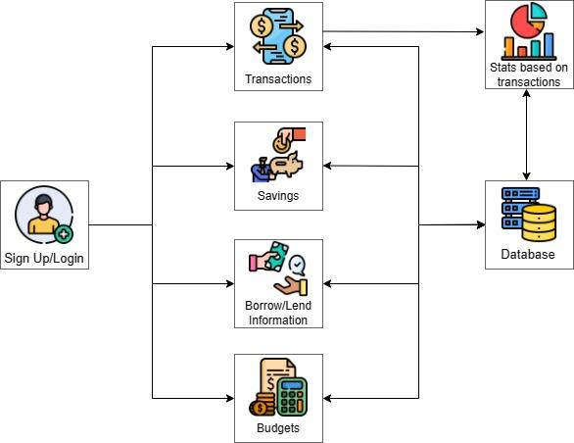
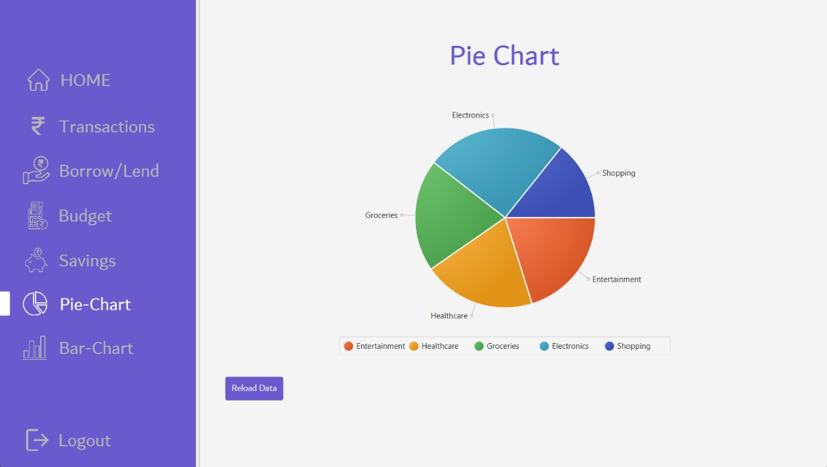
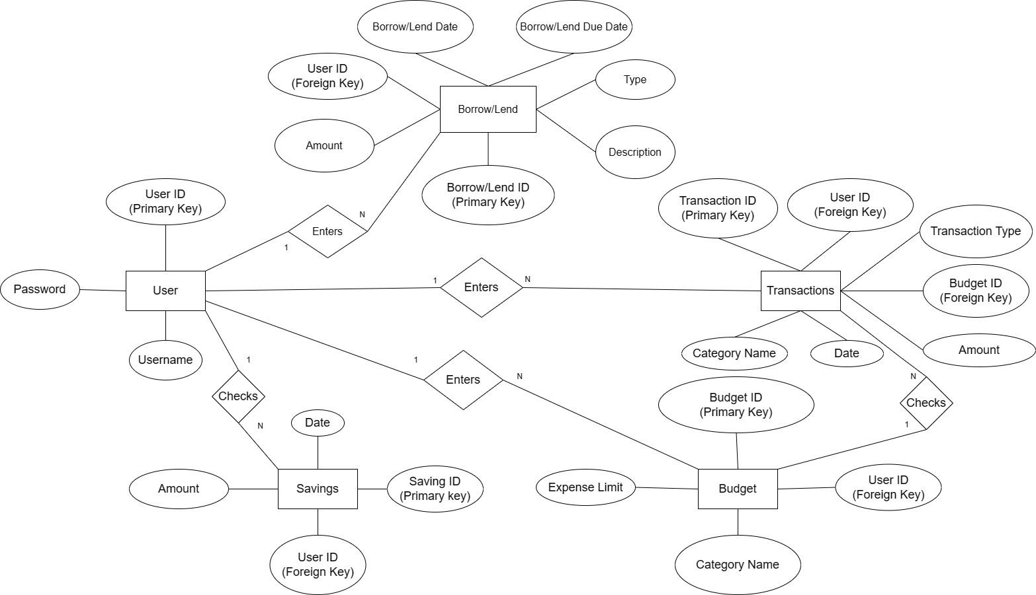
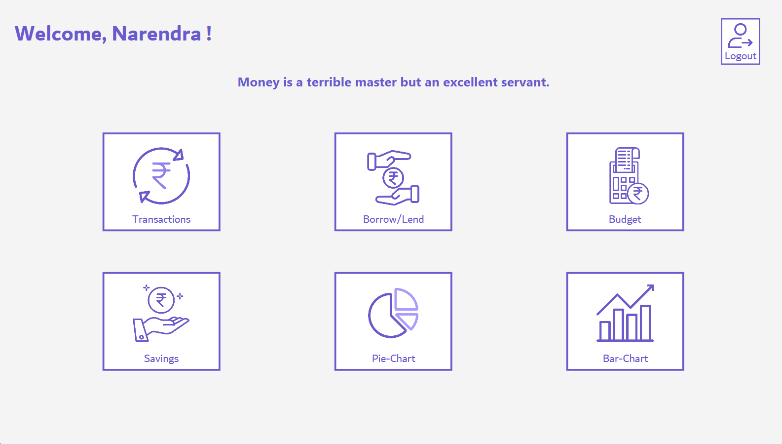
Don Bosco Institute of Technology, Mumbai
Department of Information Technology
Expense Ease -- Narendra Dukhande, Saifuddin Syed, Sanchita Warade, Lenoy Geo Thomas
Problem Statement and Scope
System Implementation
2. Pie Chart(Statistics)
The current lack of an efficient and user-friendly expense tracking solution poses a significant challenge for individuals and businesses alike.​ Manual recording and management of expenses often lead to errors, oversights, and time-consuming processes. This results in financial mismanagement, missed budgeting opportunities, and hindered decision-making. ​ A comprehensive digital expense tracker is needed to address these issues and streamline the expense management process.​
Existing Scenario
Expense tracker apps have evolved significantly, leveraging smartphones and advanced technology. They integrate with bank accounts, offer real-time tracking, automated expense categorization, and insights into spending patterns. AI and machine learning provide personalized financial advice. Data security is a priority with encryption and two-factor authentication. Some apps use subscription models for extra features and customization, providing a seamless user experience. This modern landscape offers users a variety of options for managing their finances.
Conclusion
The project aims to create a user-friendly expense tracking interface, benefiting a wide range of users. It has also been a valuable learning experience, improving technical and personal skills while teaching important lessons about collaboration and project execution. The project has provided insights into technical and organizational challenges and has demonstrated the team's commitment to continuous improvement and teamwork.
Proposed Solution
Creating a user-friendly desktop app that helps people handle their daily expenses and money matters. It makes it easy to keep tabs on one’s spending, so they can better manage their budget. One can categorize expenses for a clearer view of where their money goes, and it keeps track of their savings. Adding transactions is simple, and the user can set up a budget that suits their needs. The app also shows the user’s spending in easy-to-understand graphs and pie-charts, giving them a visual picture of their financial situation. It's a handy tool for anyone looking to take charge of their money and make smarter financial choices.
Results / Screenshot
References
1.Dashboard
1)https://apps.microsoft.com/store/detail/my-expenditures/9NS3KV8RGC8R - Expense Tracker App Reference
2)https://www.youtube.com/watch?v=ThTgN90PA44 - Connecting Java with MySQL
3) https://stackoverflow/java/javafx - JavaFX Tutorial
4)https://youtu.be/9XJicRt_FaI?si=4FFrAZm54LXQyKWH -JavaFX Youtube Channel
5) Apps referred : Expense Spy, Money Manager Pro, Expense.io, Spendee

